Slide 1
Neurodevelopmental Outcomes for Infants with Neonatal Abstinence Syndrome
Implications for
Speech-Language Pathologists
Kerry Proctor- Williams, Ph.D, CCC-SLP
Dept. of Audiology& Speech-Language Pathology
ASHA Conference, November 20, 2014

Slide 2
Disclosure
I have no relevant financial or nonfinancial relationships in the products or services described, reviewed, evaluated or compared in this presentation.
Notes:
My name is Kerry Proctor-Williams and I'm speaking on Neurodevelopmental Outcomes for Infants with Neonatal Abstinence Syndrome. I work for East Tennessee State University. I have no relevant financial or nonfinancial relationships to disclose.

Slide 3
What’s Happening in Your Community?

Slide 4
Tennessee Health Departments

Slide 5
Prevalence This Year ... So Far http://health.tn.gov/MCH/NAS/NAS_Summary_Archive.shtml

Slide 6
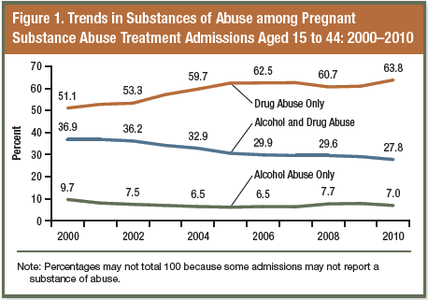
Incidence, Maternal Use & Cost Patrick et al. (2012)
Over the past decade:
4.7-fold increase in maternal opioid use
2.8-fold increase in NAS
 | Typical | Low Birth Weight | NAS
Number | 40,437 | 4,768 | 528
Cost | $4,237 | $37,668 | $62,973
Length of Stay | 3.2 | 18.3 | 32.5
Data source: Division of Health Care Finance and Administration, Bureau of TennCare (in Luskin, 2013).

Slide 7
Not Just a Rural or Urban Problem

Slide 8
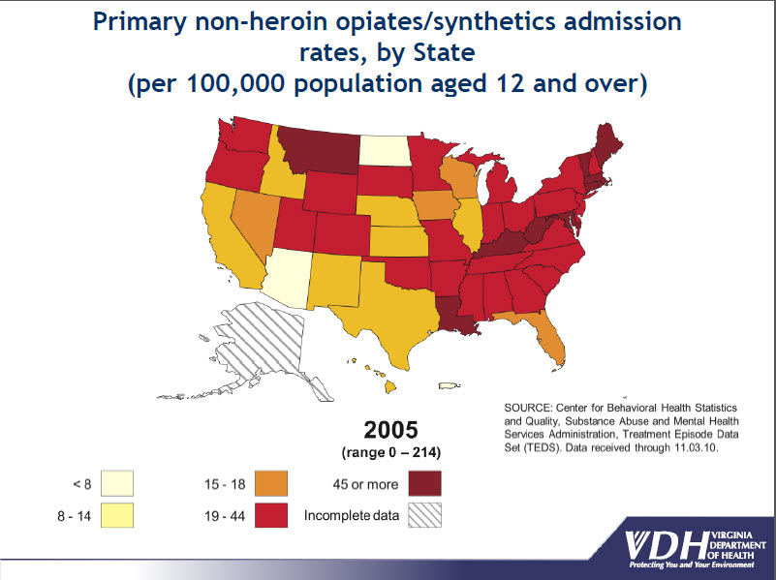
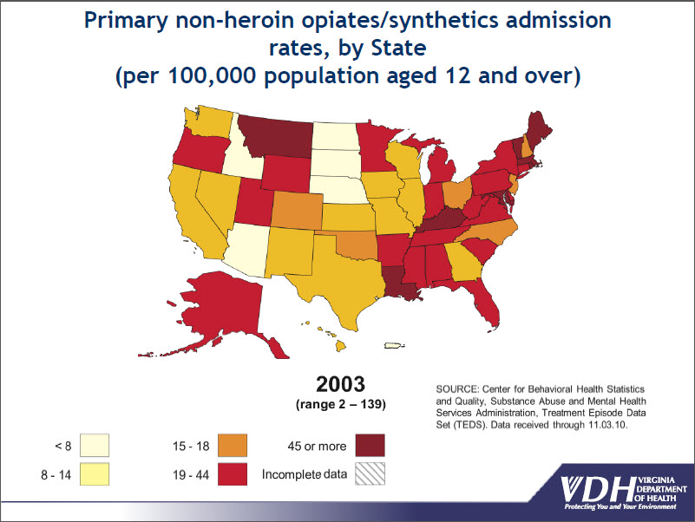
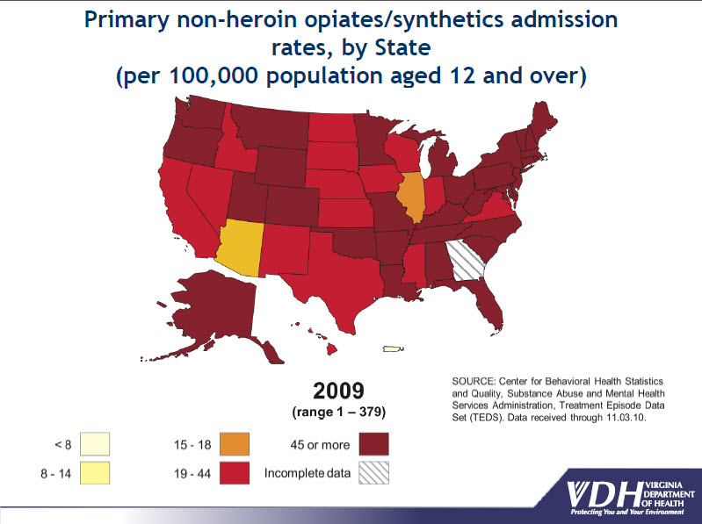
National Picture of Admissions for Non-heroin Opiate Use

Slide 9
Drug Routes

Slide 10
USA is #1 in the World Paulozzi, et al (2014)
Top 10 Opioid Prescriptions (per 100 persons)
Top 10 Benzodiazepines Prescriptions (per 100 persons)
Alabama (142.9)
Tennessee
West Virginia
Kentucky
Oklahoma
Mississippi
Louisiana
Arkansas
Indiana
Michigan (10)
West Virginia (71.9)
Alabama
Tennessee
Rhode Island
Kentucky
South Carolina
Louisiana
Arkansas
Massachusetts
Florida (46.9)
USA consumes twice as many opioids per capita than the next closest nation (Canada).
Notes:
USA consumes twice as many opioids per capita than the next closest nation (Canada).

Slide 11
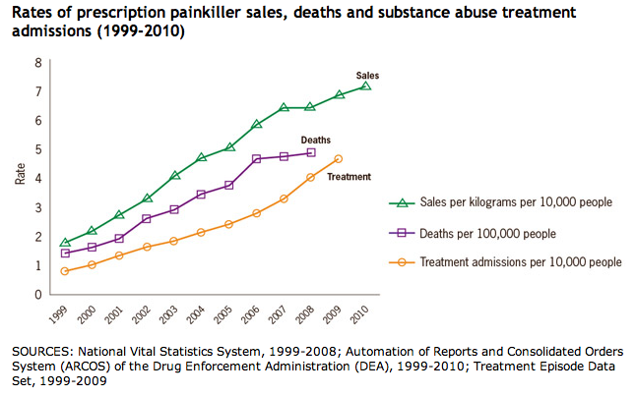
Number of Perscriptions & Outcomes
Centers for Disease Control, 2014

Slide 12
Substance Use, Misuse & Abuse
Mothers’ Choices

Slide 13
The Drugs: Supervised & Prescribed
Supervised Replacement Therapy (53.7%)
Supervised Pain Therapy (14.2%)
Methadone
Buprenorphine
Subutex
Buprenorphine /Naloxone
Suboxone
Codeine
Fentanyl
Duragesic, Fentora
Hydrocodone
Lorcet. Lortab, Vicodin
Hydromorphone
Dilaudid
Meperidine
Demerol
Oxycodone
OxyContin, Percocet, Roxicodone
Notes:
Treatment of opioid addiction

Slide 14
The Drugs: Supervised & Prescribed
Supervised Therapy for Psychiatric/Neurological Condition (6.6%)
Benzodiazepines
Xanax, Clonipin, Valium Librium, Ativan
Selective Serotonin Re-uptake Inhibitors (SSRIs)
Amphetamines
Dexedrine, Adderall
Methylphenidate
Ritalin, Concerta
Anticonvulsants
Tegretol, Dilantin, Phenobarbitol, Keppra,
Anxiety, insomnia, agitation, seizures
Depression, anxiety
ADHD, narcolepsy, obesity
Prevention of seizures
Notes:
Treatment of opioid addiction

Slide 15
Non-prescribed Drug Use
Non-prescribed Prescription Drug Use (39.3%)
Non-prescription Substance Use (20.9%)
Heroin
Cocaine
Crack Cocaine
Opium
Methamphetamine
Hallucinogens
LSD, mescaline,
psylocybin, PCP
Marijuana
Alcohol
Tobacco
(nicotine)
Oxycodone
OxyContin, Percocet, Roxicodone
Hydrocodone
Lorcet, Lortab, Vicodin*
Benzodiazepines
Xanax, Clonipin, Valium Librium, Ativan
Fentanyl
Duragesic, Fentora
Amphetamines
Dexedrine, Adderall
Codeine

Slide 16
Who are the Mothers?

Slide 17
Research indicates 99% of mothers of NAS babies have been abused. We’re still looking for the other 1%.
Dr. Tim Smyth
Pain Medicine Associates
Catalyst Health Solutions
Notes:
Let me tell you a some stories from the Sheigla Murphy and Marsha Rosenbaum’s Study: Pregnant Women on Drugs: Combating Stereotypes and Stigma

Slide 18
A Complex Population
Childhood
Adolescence & Young Adulthood
Disorganized & disrupted
Little supervision & adult responsibilities
Early exposure to drugs
Emotional, physical, sexual abuse
Victimization
Addiction
Inconsistent education, high drop out rate
Poverty
Need money for drugs
“Dating” or prostitution
Illegal activity, theft
Notes:
Krista’s story. Page 25,44

Slide 19
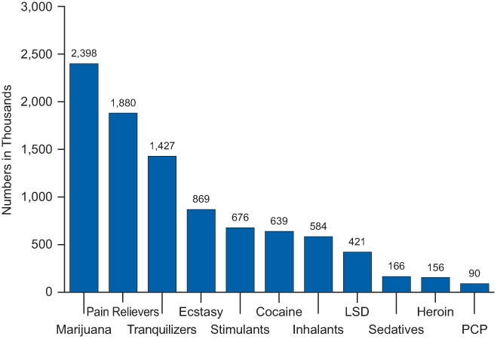
How Mothers get Started
12th Graders:
Source of Prescription Drugs 2009-11
Past Year Initiates of Illicit Drugs, 12 or Older, 2012
( SAMHSA)
4,149,000 new users
 | Amphetamines | Tranquilizers | Narcotics (not heroin)
Internet | 4.5 | 5.2 | 1.6
Took from a friend or relative* no permission | 14.2 | 22.9 | 21.8
Given by a friend* or relative | 66.4 | 78.3 | 70.2
Bought from a friend* or relative | 48.6 | 52.7 | 40.4
Prescription | 18.1 | 14.7 | 34.7
Drug dealer or stranger | 21.8 | 26.7 | 16.4
Other | 13.8 | 9.9 | 10.5
85.8% Doctor Prescription
(The Monitoring the Future Study, The University of Michigan)

Slide 20
Complex Care
Pregnancy
Health Care
Unplanned
Sexual violence
Irregular cycle
Inaccurate pregnancy tests
Responses
Guilt & worry
Fear for baby’s health, of losing the baby and partner’s reactions
Happiness at (another) chance to be a good mom and a socially sanctioned identity
Stigma
Avoid prenatal care
Abortion, miscarriage
Brace for the outcome
Denial
Harm reduction strategies
Treatment
Alter lifestyle
Switch drugs
Old wive’s tale remedies
One caring health professional can make a difference
Notes:
Jocelyn 93, Clara 108, Ethel p. 119

Slide 21
Even if we have a magic moment with each mother, there isn’t enough care for them.
Lisa Tipton
Executive Director
Families Free

Slide 22
Babies with NAS in Withdrawal
http://www.youtube.com/watch?v=6YMdbZj7_0o

Slide 25
Physiological & Behavioral Assessment
Samples from the infant’s:
Hair
Urine
Meconium
Umbilical cord blood
Timing and accuracy of the sample results depends on the half-life of the drug. For example,
Heroin 30 min
Cocaine 1 hour
Morphine 1-7 hours
Marijuana 4 hours
OxyContin 3-5 hours
Methamphetamine 12 hours
Finnegan Neonatal Abstinence Scoring System
Each behavior observed receives a designated number of points
Scored 30-60 min following a feed
Scored every 2-4 hours within 24 hours depending on severity of symptoms
Scores of > 8, or > 24 across 3 consecutive administrations indicate pharmacological therapy (morphine, phenobarbital, clonopine) is warranted

Slide 26
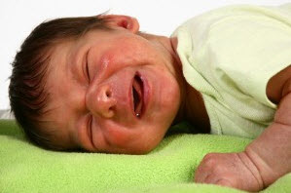
Symptoms & Assessment
Finnegan Neonatal Abstinence Scoring System
Central Nervous System Disturbances
Duration of high-pitched cry
Length of sleep following feeding
Hyperactive Moro reflex – reaction to sudden loss of support
Tremors
Increased muscle tone
Excoriation (skin abrasion) especially
knees, elbows, toes & face from
hyperactivity
Myoclonic jerks of limbs
Convulsions/seizures
Notes:
About 8 times a day, contributes to treatment: morphine, clonopine, seizure medications. There is no Standard Medical Treatment Protocol

Slide 27
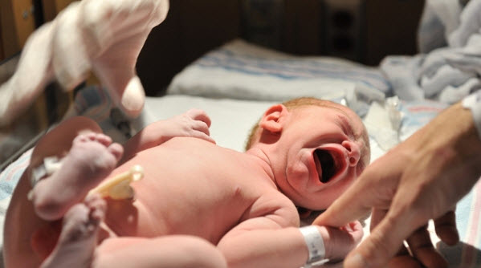
Symptoms & Assessment
Finnegan Neonatal Abstinence Scoring System
Metabolic/Vasomotor/Respiratory Disturbances
Sweating
Hyperthermia
Frequent yawning
Mottling
Nasal stuffiness
Sneezing
Nasal Flaring
Increased respiratory rate with or without retractions
Gastrointestinal Disturbances
Excessive sucking
Infrequent/uncoordinated suck
Reflux or vomiting
Loose/watery stools

Slide 28
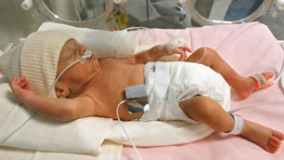
Opioid withdrawal symptoms:
May appear as early as within the first 24 hours
May take as many as 4-5 days to appear
Occur in 55-94% of exposed infants
Depend on the half-life of the substance(s) used, time last taken by mother, infant metabolism, and gestational age and/or birthweight
Not all babies exposed to drugs prenatally experience NAS

Slide 29
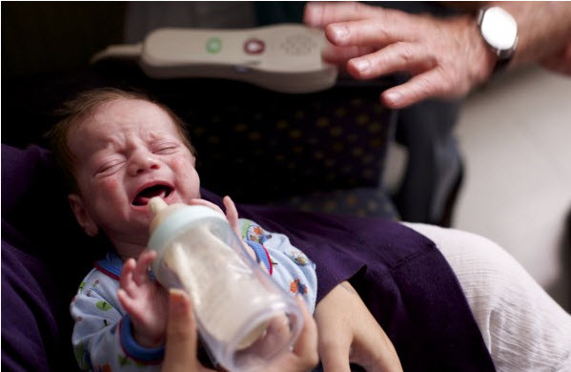
Implications for SLPs
SLPs
Feeding: establishment of coordination of breathe, suck, swallow
Assessment of alertness/ sleepiness cycle and triggers of irritability
Facilitating medical staff/parent/caregiver positive interactions and bonding with an irritable infant
Parent/caregiver education and counseling
Attitude of nconditional positive regard

Slide 30
Children’s Neurodevelopmental Outcomes

Slide 31
Prenatal Alcohol Exposure
Fetal Alcohol Syndrome Disorder is the leading identifiable and preventable nonhereditary cause of mental retardation and other birth defects in the US
Characteristics include:
facial dysmorphia - differences in brain architecture
pre- & post-natal growth deficiencies - hearing impairment
central nervous system dysfunction - impaired reflexes
general impairment in intelligence - motor coordination deficits
deficits of attention, memory, learning - executive functioning deficits
emotional regulation deficits - delays in auditory processing
These deficits contribute to ongoing behavior problems, ADHD, language and learning disabilities and hearing impairment that persist into adulthood

Slide 32
Prenatal Opiate and Cocaine Exposure
Increased risk for neurodevelopmental impairment
Identified developmental difficulties include:
Lower weight, height and head circumference,
Slower growth, and psychomotor deficits with some studies showing that these persist up to 10 years ...so far.
Subtle deficits across all or some domains of orientation, habituation, state regulation, autonomic stability, reflexes, tone, motor performance, irritability, alertness and excitability, especially at less than 6 mos.
Cognitive deficits at 18 and 36 mos and lower social maturity at 36 mos

Slide 33
Prenatal Opiate and Cocaine Exposure
Identified developmental difficulties include:
A growing consensus that prenatal cocaine exposure affects language development and contributes to receptive and expressive language delays, with particular deficits in the use of grammar, complex language and discourse at 3 and 4 years.
Difficulties in behavior, attention, language and cognition at 4-13 years
Prolonged ABR absolute and IPLs for infants who had been exposed to cocaine
Neurodevelopmental compromise of the auditory system appears to result from gestational exposure to cocaine.
Preliminary research of prenatal exposure to methamphetamine is showing similar outcomes

Slide 34
Prescription Drug Exposure.
Use of SSRIs has been linked to subtle motor developmental differences, small head circumference, behavior and social adaptability deficits, maladaptive externalizing behaviors and increased likelihood of autism
Difficulties associated with methadone treatment includes motor deficits, reduced social responsivity, and shorter attention spans.
Combined methadone and alcohol exposure predict lower cognitive and language scores

Slide 35
That’s It. That’s all we Know
Children born with NAS demonstrate ongoing neurodevelopmental difficulties beyond the initial perinatal medical symptoms and social fragility.
What we do know are that many of the impaired systems and skills are closely associated with language and auditory processing disorders
We desperately need to obtain data about this growing population’s long-term outcomes, which are virtually unknown.

Slide 36
Treatment Challenges
Mothers and their Children

Slide 37
System Insufficiency
Access to the early intervention services can be compromised because of the unavailability of services, failure to qualify, or poor coordination.
In East Tennessee, the rate for those 12 and older who need but do not receive treatment for illicit drug use in at 2.51% exceeds the rates for the state (2.34%) and is equivalent to the national average (2.54%).
The rate for those needing but not receiving treatment of alcohol use at 5.81% is lower than the state (5.93%) and national (6.90%) averages¹.
Mothers with or recovering from substance abuse are difficult to engage in community health and education services because:
The complexity of the social and medical problems
High risk for continued drug use
Perceptions about social stigma.

Slide 38
Complex Individual Challenges
It is difficult to isolate the effects of individual drugs because of polysubstance exposure of legal and illicit drugs, alcohol and tobacco
Environmental risks include:
Low socioeconomic status,
Poor prenatal care
Transience
Identification of primary caregivers
For some children with NAS, there is a period of illusory developmental competence early on and only later do the social, emotional, behavioral and learning consequences emerge.
Babies may fail to qualify for services or be discharged from services before early detection of problems is observable.

Slide 39
A Model of Addiction and Treatment

Slide 40
A Model of Care: Roles for SLPs & Audiologists

Slide 41
Implications for Caseloads
From our corner of Tennessee, we can expect
208 children with NAS to enter Kindergarten in 2017
and
182+ children with NAS to enter Kindergarten in 2018
We won’t know who all of them they are
We won’t know how their speech, language,
and literacy characteristics will present
We don’t have evidence-based practice
guidelines for their treatment
We must work together and share our knowledge

Slide 42
Sources, References, & Resources
Bandstra E. S., Morrow C. E., Mansoor, E., & Accornero, V. H. (2010). Prenatal drug exposure: Infant and Toddler Outcomes. Journal of Addictive Diseases. 2010;29:245-258.
Casper, RC, Fleisher BE, Lee-Ancajas JC, et al. Follow-up of children of depressed mothers exposed or not exposed to antidepressant drugs during pregnancy. Journal of Pediatrics. 2003;142:402-408.
Church MW, Eldis F, Blakley, BW, Bawle EV. Hearing, Language, Speech, Vestibular, and Dentofacial Disorders in Fetal Alcohol Syndrome. Alcoholism: Clinical and Experimental Research. 1997;21:227–237. doi: 10.1111/j.1530-0277.1997.tb03754.x.
Coggins, T. E., Timler, G. R., & Olswang, L. B. (2007). A state of double Jeopardy: Impact of prenatal alcohol exposure and adverse environments on the social communicative abilities of school-age children with Fetal Alcohol Spectrum Disorder, . Language, Speech, and Hearing Services in Schools, 38, 117-127.
Cone-Wesson B., & SpingarnA. Effects of maternal cocaine abuse on neonatal auditory brainstem responses. American Journal of Audiology, 2003;2(3):48.
Croen LA, Grether JK, Yoshida CK, Oudouli R, Hendrick V. Antidepressant use during pregnancy and childhood autism spectrum disorders. Archives of General Psychiatry. 2011;68:1104-1112.
Hunt RW, Tzioumi D, Collins E, Jeffery HE. Adverse neurodevelopmental outcome of infants exposed to opiates in-utero, Early Human Development. 2008;84;29-35.
Hyter, Y. D. (2007). Understanding children who have been affected by maltreatment and prenatal alcohol exposure. Language, Speech, and Hearing Services in Schools, 38, 93-98
Klinger G, Frankenthal D, Morlob P, et al. Long-term outcome following selective serotonin reuptake inhibitor induced neonatal abstinence syndrome. Journal of Perinatology. 2011;31:515-620.
Lester BM, Lagasse LL. Children of addicted women. Journal of Addictive Diseases. 2010;29: 259-276.
Logan BA, Brown MS, Hayes MJ. Neonatal abstinence syndrome: treatment and pediatric outcomes. Clinical Obstetrics and Gyneocology. 2013;56:186-192.
Luskin, K. (2013) Tennessee Efforts to Prevent Neonatal Abstinence Syndrome. Tennessee Department of Health.
Murphy, S., & Rosenbaum, M. (1999). Pregnant Women on Drugs: Combating Stereotypes and Stigma.Piscataway, NJ: Rutgers University Press.
Olson HC, Jirikowic T, Kartin D, Astley S. Responding to the challenge of early intervention for fetal alcohol spectrum disorders. Infants & Young Children. 2007;20:172-189.
Oberlander TF, Misri S, Fitzgerald CE, Kostaras X, Rurak D, Riggs W. Pharmacologic factors associated with transient neonatal symptoms following prenatal psychotropic medication exposure. Journal of Clinical Psychiatry. 2004;65:230-237.
Patrick SW, Schumacher RE, Benneyworth BD, Krans EE, McAllister JM, Davis MM. Neonatal abstinence syndrome and associated health care expenditures: United States, 2000–2009.JAMA Advance online publication. 2012. Available online at: http://jama.jamanetwork.com/
Paulozzi, et al (2014) Vital Signs: Variation Among States in Prescribing of Opioid Pain Relievers and Benzodiazepines — United States, 2012, MMWR, 63(26) 563-568
Stephen J M, Kodituwakku P W, Kodituwakku E L, Romero L, Peters A M. Sharadamma NM, & ... Coffman B A (). Delays in auditory processing identified in preschool children with FASD. Alcoholism: Clinical & Experimental Research. 2012;36(10), 1720-1727. doi:10.1111/j.1530-0277.2012.01769.x
Tan-Laxa MA, Sison-Switala C, Rintelman W, & Ostrea EM. Abnormal auditory brainstem response among infants with prenatal cocaine exposure. Pediatrics. 2004;113(2): 357-360.
Tennessee Department of Health. NAS Summary Archive. 2013. Retrieved 06/01/13
hSubstance Abuse and Mental Health Services Administration, (2012) Results from the 2011 National Survey on Drug Use and Health: Summary of National Findings, NSDUH Series H-44, HHS Publication No. (SMA) 12-4713. Rockville, MD: Substance Abuse and Mental Health Services Administration..
Thomas JD, Warren KR, Hewitt BG. Fetal Alcohol Spectrum Disorders. Alcohol Research and Health. 2010;33:118-126.
Vasquez EP, Pitts K Mejia NE. A model program: neonatal nurse practitioners providing community health care for high-risk infants. Neonatal Network. 2008;27:63-169.
Wedding D, Kohout J, Mengel MB, et al. Psychologists’ knowledge and attitudes about fetal alcohol syndrome, fetal alcohol spectrum disorders and alcohol use during pregnancy. Professional Psychology: Research & Practice. 2007;38: 208-213.

