Slide 1
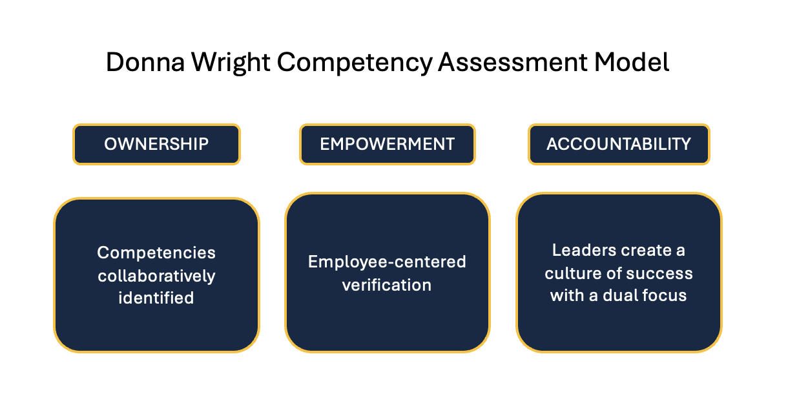
Implementation of Nursing Competency Assessment
Christina Morton, MSN, APRN, FNP-C
East Tennessee State University, College of Nursing
Introduction
Literature Review
Processes and Methods
Conclusions
What is competency?
Encompasses knowledge, skills, and behaviors
Why is competency important?
Protects patients and the nursing profession
Common themes among literature:
Lack of competency definition
Identifies gaps in knowledge and skills
Improves quality of care
Improves safety for patients and staff
Years of experience
Educational PowerPoints with skills videos sent out to nursing staff 1 week prior to competency day
2 drop-in competency days
Post-test
Return demonstration
Competencies
Injection administration
Blood pressure
Capillary blood sample
6 full time registered nurses attended
Satisfaction surveys using using Likert scale and 2 open-ended questions were completed by participants
Develop a competency policy with guidance by the Donna Wright Competency model
Participants found the competency day beneficial
Policy and procedure currently under development
Policy and procedure will be reviewed by director of compliance, clinical directors, and chief nursing officer for approval and implementation in all nurse-led clinics
Background and Significance
Patient harm has been linked to a lack of competency and insufficient policy and procedures.
There is a lack of standard universal definition of competency.
The healthcare filed is ever-changing, therefore competencies are as well.
Absence of a competency assessment can affect identifying areas where knowledge and skills may be lacking and cause delays in implementing improvements.
Leaders, educators, and managers play an important role in assessing for competency needs among nursing staff based on organizational needs.
Purpose
References
Achieve standardization of nursing competencies within nurse-led clinics
Develop a policy
Develop an electronic form to aid in ease of tracking competencies
Findings
References available on QR code
The nursing staff (n=6) found the competency day beneficial and that it promoted confidence in skills.
All participants reported never having competency assessment at the clinic
…
Aims
Validate select competencies
Develop electronic tracking form
Develop and present policy and procedure for competency assessment
Contact Information
Christina Morton, MSN, APRN, FNP-C East Tennessee State University DNP Student mortoncn@etsu.edu

